Slide 1
Taking inflection out of the paradigm box: the intersection of inflected forms and constructions
Laura A. Janda

Slide 2


Overview
SMARTool
Rich inflectional morphology: Zipfian distribution & “Paradigm Cell Filling Problem”
A data-based model of rich morphology and a machine-learning experiment
The Russian Constructicon
Theory and purpose
Content and target audience
User-Friendly interface

Slide 3
Both resources are open-source hosted on github, designed so that other researchers can re-use our code to create parallel resources for other languages

Slide 4

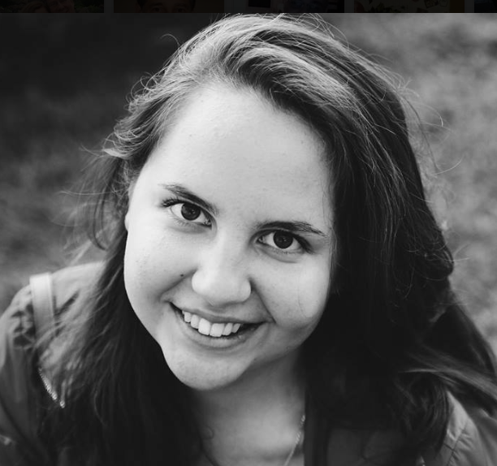

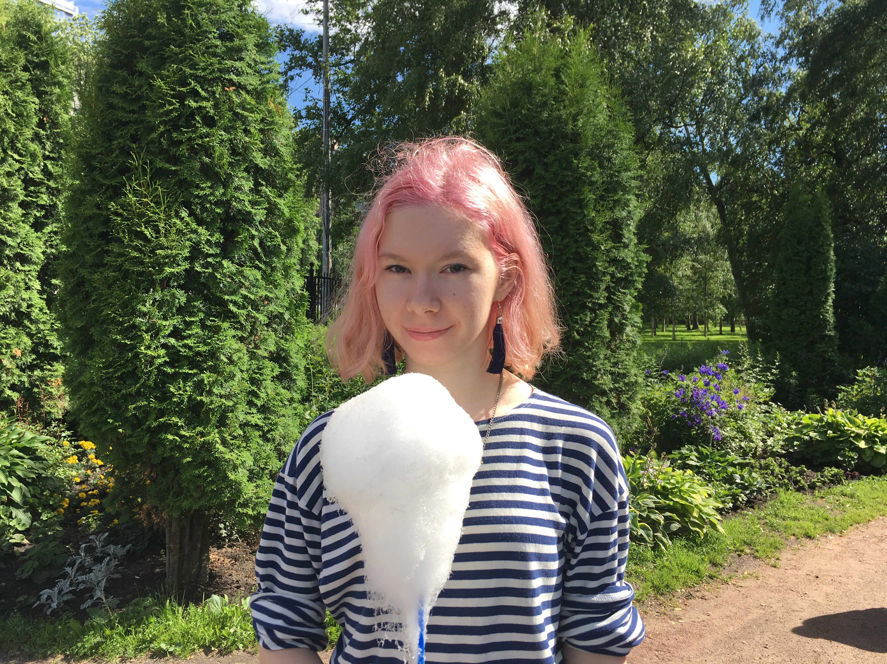

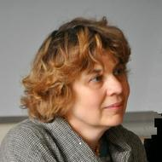
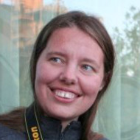

Members of the SMARTool and Constructicon teams
Anna Endresen
Financing and collaboration
Financed by the Norwegian Agency for International Cooperation and Quality Enhancement in Higher Education as a collaboration between UiT the Arctic University of Norway and the Higher School of Economics in Moscow
Radovan Bast
Tore Nesset
Francis Tyers
Mikhail Kopotev
Valentina
Zhukova
Elizaveta
Kibisova
Svetlana Sokolova
Evgeniia Sudarikova
Ekaterina Rakhilina
Olga
Lyashevskaya
James
McDonald
Daria Mordashova

Slide 5

Strategic Mastery of Russian Tool
http://uit-no.github.io/smartool/

Slide 6
Strategic targeting of rich inflectional morphology for linguistic analysis and L2 acquisition
What I used to believe:
students need to memorize full paradigms in order to achieve fluency
What I now believe:
full paradigms are a fiction and we can strategically target acquisition of morphology

Slide 7
Challenges of rich inflectional morphology
Most languages have rich inflectional morphology
Rich inflectional morphology can involve huge numbers of forms
Inflectional morphology can be complex

Slide 8
Most languages have rich inflectional morphology: A sample from Europe
HIGH | Slavic: Bosnian, Croatian, Czech, Montenegran, Polish, Russian, Rusyn, Serbian, Slovak, Slovene, Sorbian Other Indoeuropean: Albanian, Greek, Irish, Latvian, Lithuanian, Romany, Scottish Gaelic, Welsh Uralic : Estonian, Finnish, Hungarian, Kven, Saami Other: Basque, Maltese, Turkish
MID | Slavic: Bulgarian, Macedonian Other Indoeuropean: Catalan, French, German, Italian, Luxembourgish, Portuguese, Spanish, Yiddish
LOW | Germanic språk: Danish, Dutch, English, Norwegian, Swedish

Slide 9
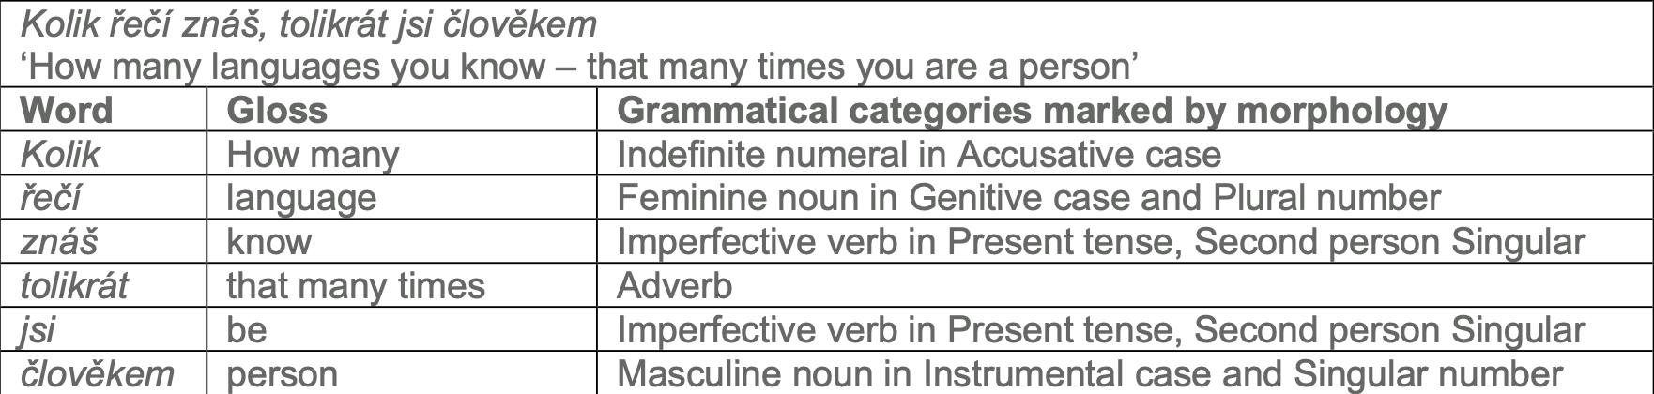
Rich inflectional morphology can involve huge numbers of forms
Inflectional morphology in a Czech proverb
In a language with rich inflectional morphology, even a small basic vocabulary can entail hundreds of thousands of paradigm forms.

Slide 10
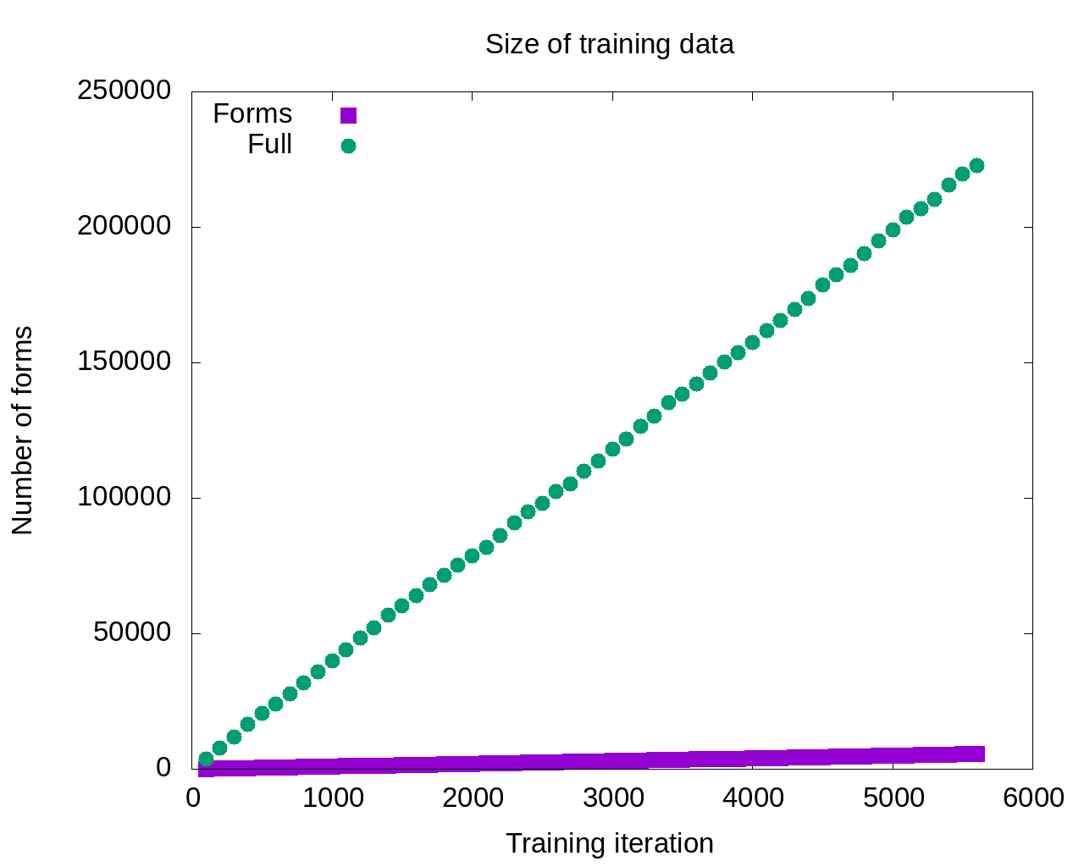
Number of inflected words
Number of paradigm forms

Slide 11
Inflectional morphology can be complex
Morphology is considered both to be essential to L2 acquisition and to be a “bottleneck”, more difficult than both syntax and semantics (Slabakova 2009 & 2014, Jensen et al. 2019)
Morphophonemic alternations can complicate the picture – inflectional morphology is not always a matter of adding desinences to stems
consonant and vowel alternations
fleeting vowels (jers)
suprasegmental alternations

Slide 12
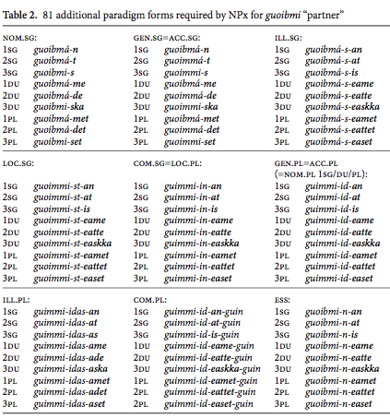
North Saami example
 |  | Basic paradigm of guoibmi “partner”
 |  | nom.sg | guoibmi
 |  | gen.sg=acc.sg | guoimmi
 |  | ill.sg | guoibmá-i
 |  | loc.sg | guoimmi-s
 |  | com.sg=loc.pl | guimmi-in
 |  | nom.pl | guoimmi-t
 |  | gen.pl=acc.pl | guimmi-id
 |  | ill.pl | guimmi-ide
 |  | com.pl | guimmi-iguin
 |  | ess | guoibmi-n

Slide 13
Zipfian distribution
Language & Corpus Name | Corpus Size | Paradigm Size | Total Lexemes | Lexemes with full Paradigm | % Lexemes with full Paradigm
English Web Treebank | 254,830 | 2 | 6,369 | 1,524 | 23.92%
Norwegian Dependency Treebank | 311,277 | 4 | 12,587 | 393 | 3.12%
Russian SynTagRus | 1,032,644 | 12 | 21,945 | 13 | 0.06%
Czech Prague Dependency Treebank | 1,509,242 | 14 | 17,904 | 3 | 0.02%
Estonian ArborEst | 234,351 | 28 | 14,075 | 0 | 0%

Slide 14
Zipfian distribution
Language & Corpus Name | Corpus Size | Paradigm Size | Total Lexemes | Lexemes with full Paradigm | % Lexemes with full Paradigm
English Web Treebank | 254,830 | 2 | 6,369 | 1,524 | 23.92%
Norwegian Dependency Treebank | 311,277 | 4 | 12,587 | 393 | 3.12%
Russian SynTagRus | 1,032,644 | 12 | 21,945 | 13 | 0.06%
Czech Prague Dependency Treebank | 1,509,242 | 14 | 17,904 | 3 | 0.02%
Estonian ArborEst | 234,351 | 28 | 14,075 | 0 | 0%
Because Zipf’s Law scales up, these numbers will never change substantially, no matter how large the corpus is

Slide 15
Language Exposure as a Big Corpus
A large corpus is a close approximation to the lifetime linguistic input for a native speaker, estimated at about 5-10 million words per year
Zipfian distributions remain the same even for very large corpora, like those that approximate a speaker’s exposure to their native language
A native speaker of Russian encounters all twelve paradigm forms of less than 0.1% of nouns that they are exposed to in a lifetime
The portion of adjectives and verbs attested in all paradigm forms is virtually zero.

Slide 16
What this means for words
At the word level, each lemma has a unique “grammatical profile” -- frequency distribution of its paradigm forms

Slide 17
Full paradigms
‘fear’ ‘soldier’ ‘department’ ‘concept’ ‘memory’
sg.nom | страх | солдат | отделение | концепция | память
sg.gen | страха | солдата | отделения | концепции | памяти
sg.dat | страху | солдату | отделению | концепции | памяти
sg.acc | страх | солдата | отделение | концепцию | память
sg.ins | страхом | солдатом | отделением | концепцией | памятью
sg.loc | страхе | солдате | отделении | концепции | памяти
pl.nom | страхи | солдаты | отделения | концепции | памяти
pl.gen | страхов | солдат | отделений | концепций | памятей
p.dat | страхам | солдатам | отделениям | концепциям | памятям
pl.acc | страхи | солдат | отделения | концепции | памяти
pl.ins | страхами | солдатами | отделениями | концепциями | памятями
pl.loc | страхах | солдатах | отделениях | концепциях | памятях

Slide 18
Paradigm forms attested in 1M words
‘fear’ ‘soldier’ ‘department’ ‘concept’ ‘memory’
sg.nom | страх | солдат | отделение | концепция | память
sg.gen | страха | солдата | отделения | концепции | памяти
sg.dat | страху | солдату | отделению | концепции | памяти
sg.acc | страх | солдата | отделение | концепцию | память
sg.ins | страхом | солдатом | отделением | концепцией | памятью
sg.loc | страхе |  | отделении | концепции | памяти
pl.nom | страхи | солдаты | отделения
pl.gen | страхов | солдат | отделений | концепций
p.dat |  | солдатам
pl.acc | страхи | солдат | отделения | концепции
pl.ins | страхами |  | отделениями | концепциями
pl.loc | страхах | солдатах | отделениях
bold >20%, plain >10%, gray 1-9%, (blank) not attested

Slide 19
Full paradigms
‘background’ ‘champion’ ‘expanse’ ‘frame’ ‘problem’
sg.nom | фон | чемпион | протяжение | рамка | трудность
sg.gen | фона | чемпиона | протяжения | рамки | трудности
sg.dat | фону | чемпиону | протяжению | рамке | трудности
sg.acc | фон | чемпионa | протяжение | рамку | трудность
sg.ins | фоном | чемпионом | протяжением | рамкой | трудностью
sg.loc | фоне | чемпионе | протяжении | рамке | трудности
pl.nom | фоны | чемпионы | протяжения | рамки | трудности
pl.gen | фонов | чемпионов | протяжений | рамок | трудностей
p.dat | фонам | чемпионам | протяжениям | рамкам | трудностям
pl.acc | фоны | чемпионов | протяжения | рамки | трудности
pl.ins | фонами | чемпионами | протяжениями | рамками | трудностями
pl.loc | фонах | чемпионах | протяжениях | рамках | трудностях

Slide 20
Paradigm forms attested in 1M words
‘background’ ‘champion’ ‘expanse’ ‘frame’ ‘problem’
sg.nom | фон | чемпион |  |  | трудность
sg.gen | фона | чемпиона |  |  | трудности
sg.dat |  | чемпиону |  |  | трудности
sg.acc |  | чемпионa |  |  | трудность
sg.ins |  | чемпионом |  |  | трудностью
sg.loc | фоне |  | протяжении
pl.nom |  | чемпионы |  | рамки | трудности
pl.gen |  | чемпионов |  | рамок | трудностей
p.dat |  | чемпионам
pl.acc |  | чемпионов |  | рамки | трудности
pl.ins |  | чемпионами |  | рамками | трудностями
pl.loc |  |  |  | рамках | трудностях
bold >20%, plain >10%, gray 1-9%, (blank) not attested

Slide 21
Paradigm Cell Filling Problem (Ackerman et al. 2009)
Native speakers of languages with complex inflectional morphology routinely recognize and produce forms that they have never encountered.
Example:
Russian gerund nedokarmlivaja ‘while underfeeding’ has no attestations in the Russian National Corpus (>360M words ≈ lifetime exposure), but all native speakers of Russian can be expected to readily understand and to produce these forms in appropriate contexts, as evidenced by rare occurrences that turn up in Google searches.

Slide 22
A data-based model of rich morphology
Instead of a table of equiprobable cells:
A multidimensional space that is partially populated in many different ways by many different lexemes
Inflectional morphology can be mastered through exposure to partially overlapping subsets of paradigms
This cognitively plausible model explains why native speakers have the intuition that full paradigms exist

Slide 23
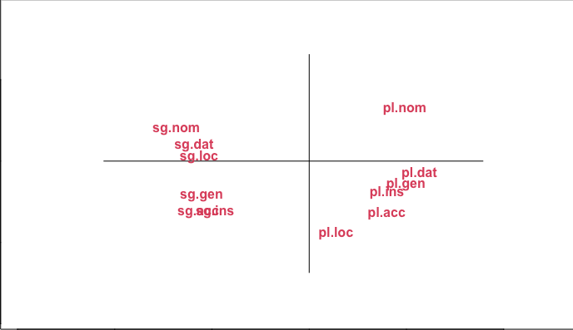
The “space” of the paradigm of Russian masculine animate nouns
as determined by corpus data

Slide 32
Masculine animates

Slide 33
Any single lexeme gives exposure to only a subset of the paradigm.
Each lexeme has a different subset of most typical forms.
Collectively they populate the entire “space” of case/number combinations.
Masculine animates

Slide 34
pl.nom аналитики отмечают
‘analysts make the point that’
The typical wordforms
are motivated by constructions
sg.ins стать/быть чемпионом
‘become/be the champion’
Masculine animates

Slide 35
A machine-learning experiment
Based on an ordered list of the most frequent forms for nouns, verbs, and adjectives in SynTagRus (1M gold standard)
Machine learning: training, testing
Given the 100 most frequent forms, predict the next 100 most frequent forms
Given the 200 most frequent forms, predict the next 100 most frequent forms
Given the 300 most frequent forms, predict the next 100 most frequent forms
… until 5400, when SynTagRus runs out of data
Testing is always: Predict paradigm forms for 100 previously unseen words
Two versions of experiment:
Training on entire paradigm, all forms
Training only on the single most frequent form

Slide 36
Data for training and testing from SynTagRus
Frequency & Form | Lemma | POS | Parse of form
1447 может | мочь | VERB | Aspect=Imp|Mood=Ind|Number=Sing|Person=3|Tense=Pres|VerbForm=Fin|Voice=Act
1286 года | год | NOUN | Animacy=Inan|Case=Gen|Gender=Masc|Number=Sing
999 лет | год | NOUN | Animacy=Inan|Case=Gen|Gender=Masc|Number=Plur
832 году | год | NOUN | Animacy=Inan|Case=Loc|Gender=Masc|Number=Sing
813 время | время | NOUN | Animacy=Inan|Case=Acc|Gender=Neut|Number=Sing
678 россии | россия | NOUN | Animacy=Inan|Case=Gen|Gender=Fem|Number=Sing
571 могут | мочь | VERB | Aspect=Imp|Mood=Ind|Number=Plur|Person=3|Tense=Pres|VerbForm=Fin|Voice=Act
571 люди | человек | NOUN | Animacy=Anim|Case=Nom|Gender=Masc|Number=Plur
543 россии | россия | NOUN | Animacy=Inan|Case=Loc|Gender=Fem|Number=Sing
436 является | являться | VERB | Aspect=Imp|Mood=Ind|Number=Sing|Person=3|Tense=Pres|VerbForm=Fin|Voice=Act
416 случае | случай | NOUN | Animacy=Inan|Case=Loc|Gender=Masc|Number=Sing
411 людей | человек | NOUN | Animacy=Anim|Case=Gen|Gender=Masc|Number=Plur
403 страны | страна | NOUN | Animacy=Inan|Case=Gen|Gender=Fem|Number=Sing
400 жизни | жизнь | NOUN | Animacy=Inan|Case=Gen|Gender=Fem|Number=Sing

Slide 38
So the model that gets the most input should be the most successful, right?

Slide 39

Maybe not…
So the model that gets the most input should be the most successful, right?

Slide 40
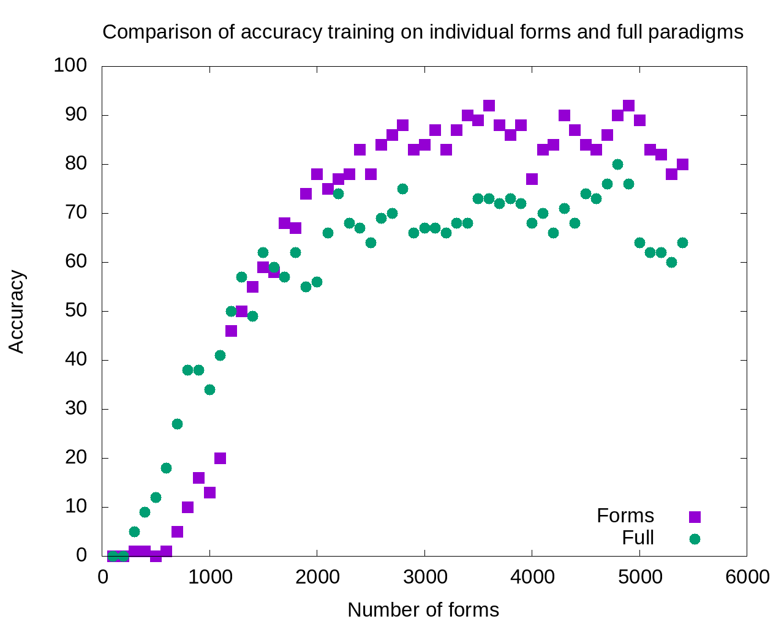
1800-5400:
Single forms model outperforms
full paradigms

Slide 41
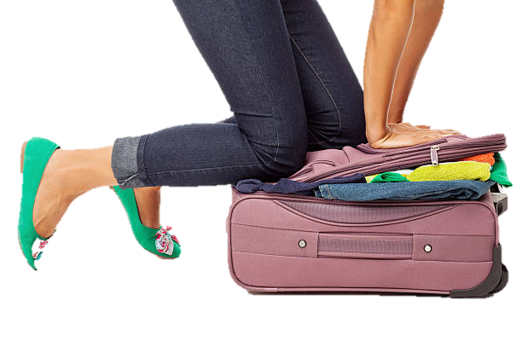
Excess data is probably overpopulating the search domain

Slide 42
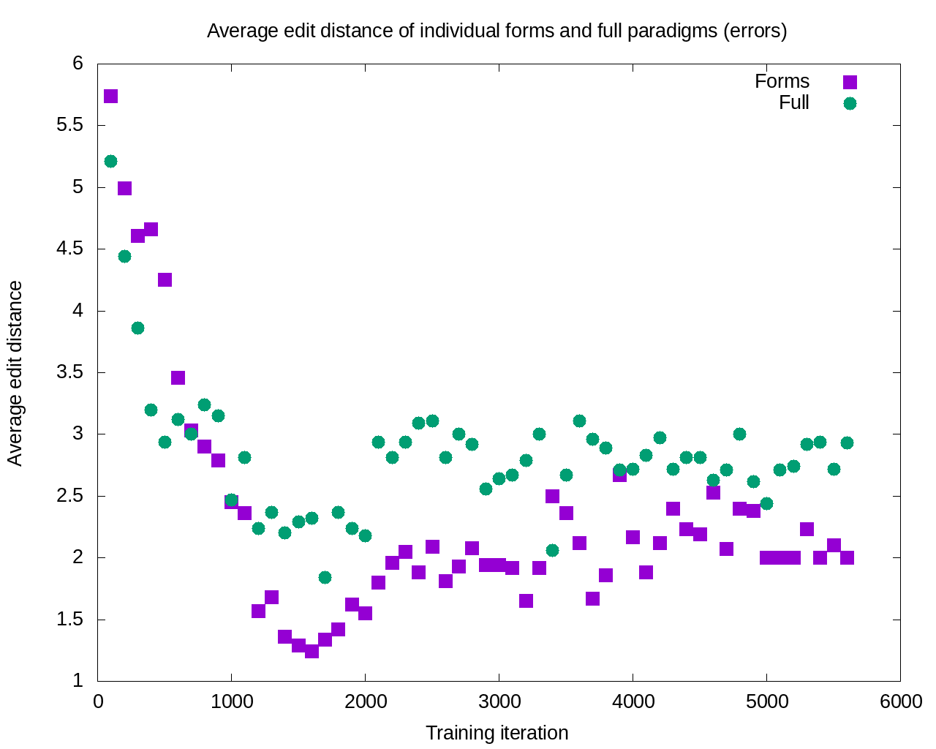
After 11 iterations, the errors committed by the single forms model are consistently smaller

Slide 43
Machine-learning experiment: Summary
Learning is potentially enhanced by focus only on the most typical wordforms attested for each lexeme: accuracy increases and severity of errors decreases
This finding is consistent with a usage-based cognitively plausible model

Slide 44
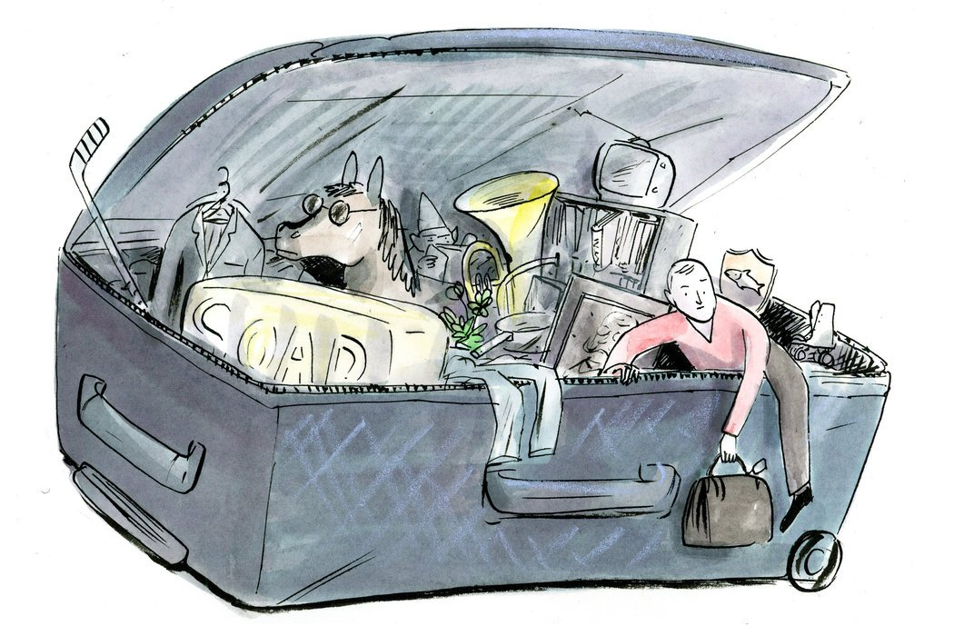
How Can We Escape From Overstuffed Paradigms?
Textbooks have always focused on certain forms and constructions
Now we can do this in a scientific, consistent way

Slide 45
The SMARTool:
Inspired by research on the distribution and simulated learning of Russian wordforms (cognitively plausible)
Strategic focus on the highest frequency wordforms and contexts that motivate their use (usage-based)
Reduces the task of learning a basic vocabulary of about 3,000 lexemes by over 90%
Can be continuously updated and custom-tailored
Potentially portable to other languages with rich inflectional morphology

Slide 46
Vocabulary Selection from 5 Textbooks and Лексический минимум; Balanced for Nouns, Verbs, Adjs (RNC ratio)
CEFR Level | ACTFL Equivalent | Russian Equivalent | SMARTool number of lexemes
A1 “Beginner” | Novice Low-Mid | ТЭУ Элементарный уровень | 500
A2 “Elementary” | Novice High | ТБУ Базовый уровень | 500
B1 “Intermediate” | Intermediate Low-Mid | ТРКИ-1 I Cертификационный уровень | 1,000
B2 “Upper Intermediate” | Intermediate High-Advanced Low | ТРКИ-2 | 1,000

Slide 47

Typical Contexts Illustrated by Examples
For each lexeme we identify 3 most common wordforms and most typical grammatical constructions and lexical collocations, and provide corpus-inspired example sentences
Based on queries:
SynTagRus Corpus
the Russian National Corpus (http://ruscorpora.ru)
the Collocations Colligations Corpora (http://cococo.cosyco.ru/)
the Russian Constructicon (https://constructicon.github.io/russian/)

Slide 48
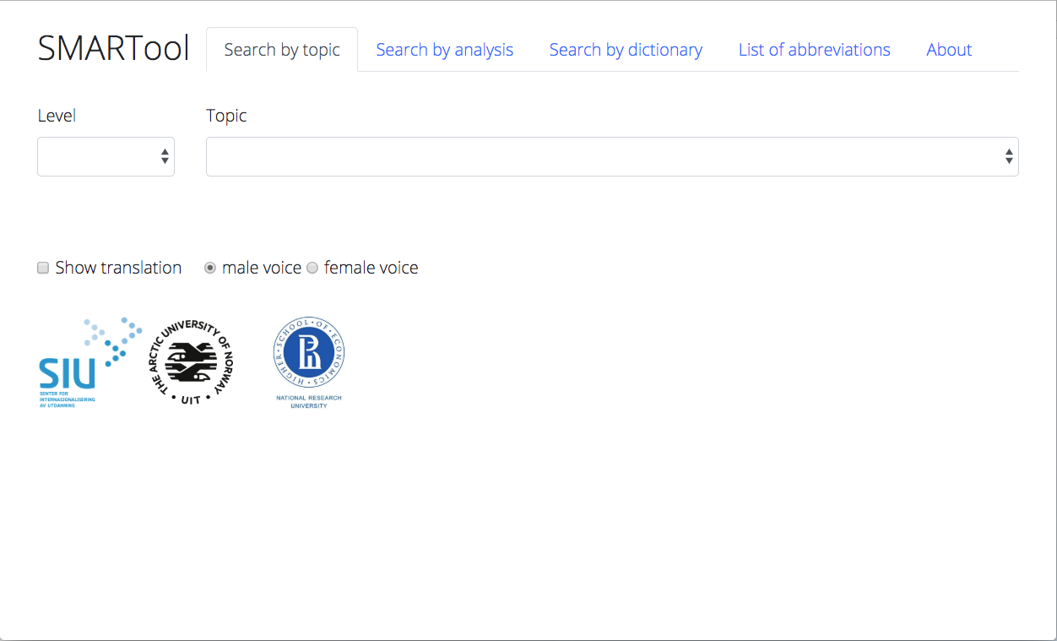
Select a Level
2) Search by topic, analysis, dictionary
Find the SMARTool here:
https://smartool.github.io/smartool/

Slide 49
The Russian Constructicon
http://constructicon.github.io/russian/

Slide 50
What is a construction?
A construction is:
any conventionalized form-meaning pairing in a language, at any level of complexity, from morpheme through lexeme through phrase to discourse structure (Goldberg 2006, 5)
the basic (though not elementary) unit that structures language
A construction may be compositional or non-compositional
All meaningful units of a language are constructions
An entire language can be described in terms of constructions

Slide 51
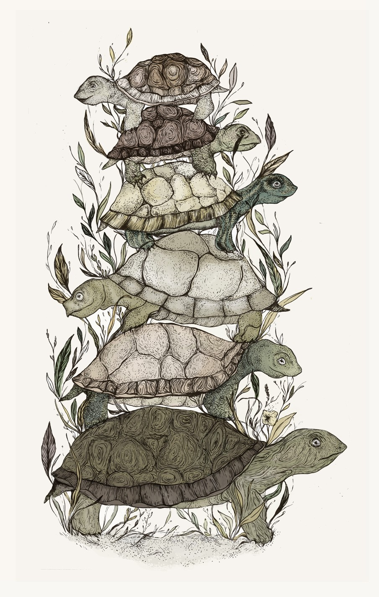
“It’s constructions all the way down” (Goldberg 2006: 18)

Slide 52

Examples of Russian constructions
morphemes
-t’ = INF
lexemes
tancevat’ ‘dance’
multi-word idioms where all slots are fixed
tancevat’ ot Adama ‘start from the very beginning’
multi-word expressions with open slots
VP pod NP-Acc
Ona tancevala pod muzyku ‘She danced to the music’
larger discourse units
Our project focuses mainly on this type of construction

Slide 53
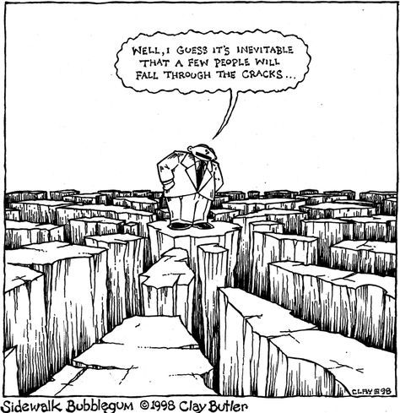
Filling in the gaps
It seems that a few things
just fall through the cracks
Dictionaries, grammars, and textbooks focus primarily on lexemes, lexicalized idioms, inflectional paradigms,and grammatical patterns
Multi-word expressions with open slots are less reliably represented in standard resources
TEXTBOOK
PHRASE
BOOK
GLOSSARY
DICTIONARY
REFERENCE
GRAMMAR

Slide 54
What is a constructicon?
A constructicon is:
a structured inventory of constructions in a given language
Constructicons exist for:
English
German
Swedish
Japanese
Brazilian Portuguese
The Russian Constructicon is by far the largest,
with over 2200 constuctions

Slide 55
Why build a constructicon?
For linguists
to achieve improved description of languages
to extend theory of construction grammar
to facilitate cross-linguistic typological comparison
For L2 learners
to achieve greater language proficiency
to motivate use of specific wordforms
to fill in gaps in current language resources and pedagogy

Slide 56
How to build a constructicon: Classification of constructions
Families
a family is a relatively homogeneous group of approx. 2-9 constructions that share some semantic, syntactic, and/or structural properties
the constructions in a family share various subsets of these properties
semantic and syntactic tags facilitate identification of families
annotation by a panel of three native speakers
Clusters
a cluster is a group of families that are linked through semantic and/or syntactic similarities in a prototypical vs. peripheral distribution, usually corresponding to semantic subtypes in annotation
Networks
a network is a group of clusters that share a general semantic tag

Slide 57
Constructionalization as grammaticalization
Conventionalization of form-meaning pairings can be understood as an early stage in the process of grammaticalization
The semantic tags are quasigramatical meanings that are distributed across constructions and their (partially bleached) anchor words
Classification rests on lexical functions (cf. Mel’čuk, Apresjan) which are comparable across languages

Slide 58
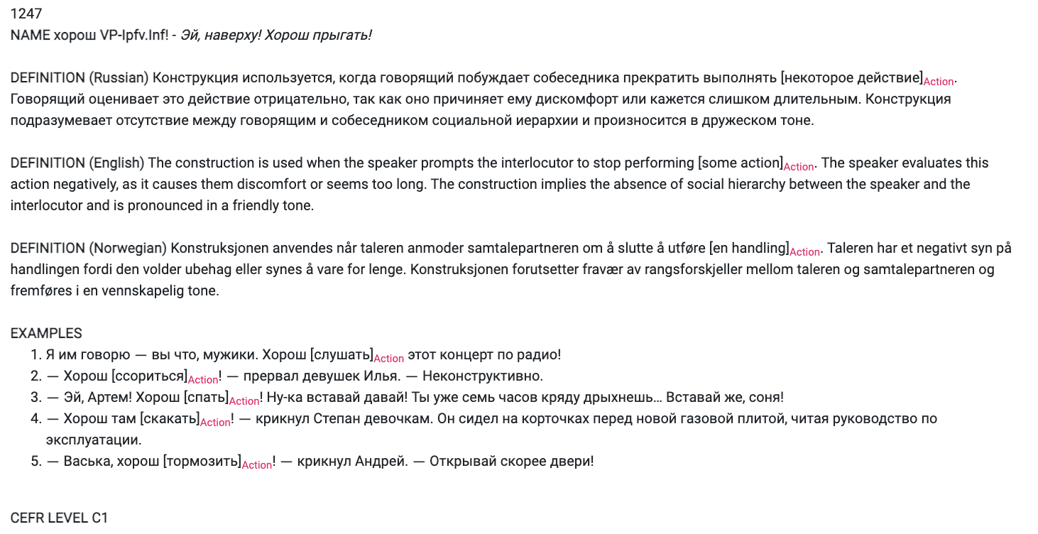
An example of a Prohibitive construction

Slide 59
anchor
slot

Slide 60
Legend:
overlap with Intensity
semantic transitions
syntactic/formal similarities
1:2 (7 constructions)
General rules
Ne VP-Inf!
‘No X-ing!’
weaker relationships
1:4 (7 constructions)
Prohibition of smallest portion
Nikakix NP-Gen!
‘No X-es!’
1:5 (3 constructions)
Anticipation of resistance
Ne VP-Fut.2!
‘You’re not going to do X!’
overlap with other networks of cxns
Cluster 1
predicative
generalization
intensification
opposition to resistance
generalization
option
opposition to repetition
overlap with Request
1:3 (9 constructions)
Milder tone
(NP-Dat) ne stoit VP-Inf
‘There’s no point in X-ing’
1:1 (4 constructions)
Prevention of intended activity
Ne smej VP-Imp.Inf
‘Don’t you dare X’
1:6 (2 constructions)
Prohibition against repeating
Čtob(y) Pron bol’še ne VP-Past!
‘No more X-ing!’
overlap with Warning
attenuation
predicative
continuative
imperative
1247
continuative
continuative
2:2 (7 constructions)
Quantitative, milder tone
Xvatit (Pron.2-Dat) VP-Imp.Inf!
‘Enough X-ing!’
2:1 (4 constructions)
Stop unwanted activity
Brosit’-Imper VP-Imp.Inf
‘Stop X-ing!’
aggression
2:5 (3 constructions)
Prohibition and Threat
Ja Pron-Dat VP-Fut!
‘You do X and you will regret it!’
overlap with Threat
attenuation
imperative
option
Cluster 2
further attenuation
imperative
temporary
Network of Prohibitive constructions
2:3 (2 constructions)
Delimitative
po-VP-Imp.Past i xvatit
‘You’ve done enough X-ing’
imperative
option, po- prefix option
2:4 (3 constructions)
Stop temporarily
Podoždat’-Imper VP-Imp.Inf
‘Stop X-ing for a while’
po- prefix

Slide 61
General information about resource
The Russian Constructicon is a free open access electronic resource that offers a searchable database of Russian constructions
Name: Constructicon means a structured inventory of constructions
Content: 2265 multi-word grammatical constructions & descriptions of their properties & corpus-based illustrations
Target audience: students and teachers of Russian as a foreign language, researchers, specialists in natural language processing
Time spent creating it: 5 years, 2016 – 2020 (2021)
User-friendly interface: https://constructicon.github.io/russian/

